Slide 1
Cloud COMPUTING & securities

Slide 2
AGENDA :
What is Cloud?
What is Cloud Computing?
Cloud Computing Technologies ?
Cloud Computing Architecture ?
Cloud Computing Infrastructure ?
Cloud Computing Providers ?
PRACTICAL SESSION (USING AWS [AMAZON WEB SERVICES]) !
Cloud Computing Security .

Slide 3
What is Cloud?
The term Cloud refers to a Network or Internet. In other words, we can say that Cloud is something, which is present at remote location. Cloud can provide services over public and private networks, i.e., WAN, LAN or VPN.
Applications such as e-mail, web conferencing, customer relationship management (CRM) execute on cloud.

Slide 4
What is Cloud Computing?
Cloud Computing refers to manipulating, configuring, and accessing the hardware and software resources remotely. It offers online data storage, infrastructure, and application.
Cloud computing offers platform independency, as the software is not required to be installed locally on the PC. Hence, the Cloud Computing is making our business applications mobile and collaborative.

Slide 5
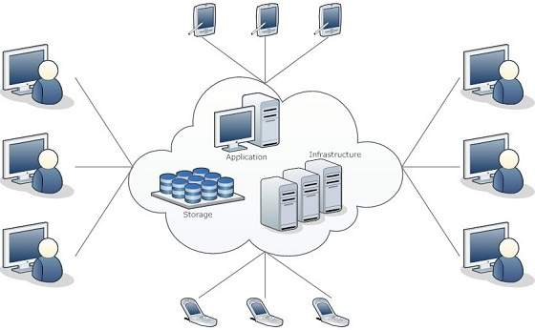

Slide 6
Basic Concepts :
There are certain services and models working behind the scene making the cloud computing feasible and accessible to end users. Following are the working models for cloud computing:
Deployment Models
Service Models

Slide 7
Deployment Models:
Deployment models define the type of access to the cloud, i.e., how the cloud is located?
Cloud can have any of the four types of access: Public, Private, Hybrid, and Community.

Slide 8
PUBLIC CLOUD :
The public cloud allows systems and services to be easily accessible to the general public. Public cloud may be less secure because of its openness.
The private cloud allows systems and services to be accessible within an organization. It is more secured because of its private nature.
PRIVATE CLOUD :

Slide 9
HYBRID CLOUD:
COMMUNITY CLOUD:
The community cloud allows systems and services to be accessible by a group of organizations.
The hybrid cloud is a mixture of public and private cloud, in which the critical activities are performed using private cloud while the non-critical activities are performed using public cloud.

Slide 10
Service Models :
Cloud computing is based on service models. These are categorized into three basic service models which are –
Infrastructure-as–a-Service (IaaS)
Platform-as-a-Service (PaaS)
Software-as-a-Service (SaaS)

Slide 11
INFRASTRUCTURE-AS-A-SERVICE (IAAS)
IaaS provides access to fundamental resources such as physical machines, virtual machines, virtual storage, etc.
Example :
DigitalOcean, Amazon Web Services (AWS), Microsoft Azure, Google Compute Engine (GCE)

Slide 12
PLATFORM-AS-A-SERVICE (PAAS):
PaaS provides the runtime environment for applications, development and deployment tools, etc.
Example :
AWS Elastic Beanstalk, Windows Azure, Heroku, Google App Engine, Apache Stratos, OpenShift.

Slide 13
SOFTWARE-AS-A-SERVICE (SAAS)
SaaS model allows to use software applications as a service to end-users.
Example:
Google Apps, Dropbox, Salesforce etc.

Slide 14
Benefits:
Cloud Computing has numerous advantages. Some of them are listed below -
One can access applications as utilities, over the Internet.
One can manipulate and configure the applications online at any time.
It does not require to install a software to access or manipulate cloud application.
Cloud Computing offers online development and deployment tools, programming runtime environment through PaaS model.
Cloud resources are available over the network in a manner that provide platform independent access to any type of clients.
Cloud Computing offers on-demand self-service. The resources can be used without interaction with cloud service provider.
Cloud Computing is highly cost effective because it operates at high efficiency with optimum utilization. It just requires an Internet connection
Cloud Computing offers load balancing that makes it more reliable.

Slide 15
Cloud Computing Technology : Virtualization->
Virtualization is a technique, which allows to share single physical instance of an application or resource among multiple organizations or tenants (customers). It does this by assigning a logical name to a physical resource and providing a pointer to that physical resource when demanded.
The Multitenant architecture offers virtual isolation among the multiple tenants. Hence, the organizations can use and customize their application as though they each have their instances running.

Slide 16
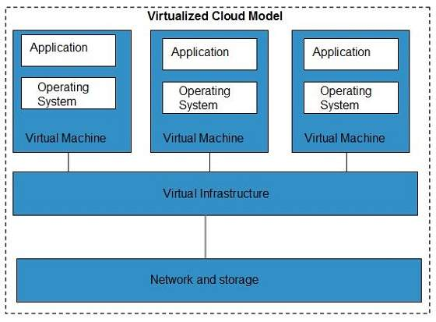

Slide 17
Cloud Computing Architecture :
Cloud Computing architecture comprises of many cloud components, which are loosely coupled. We can broadly divide the cloud architecture into two parts:
Front End
Back End

Slide 18

Front End :
The front end refers to the client part of cloud computing system. It consists of interfaces and applications that are required to access the cloud computing platforms, Example - Web Browser.

Slide 19

Back End :
The back End refers to the cloud itself. It consists of all the resources required to provide cloud computing services. It comprises of huge data storage, virtual machines, security mechanism, services, deployment models, servers, etc.

Slide 20
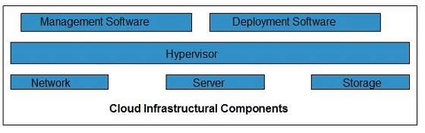
Cloud infrastructure:
consists of servers, storage devices, network, cloud management software, deployment software, and platform virtualization.

Slide 21
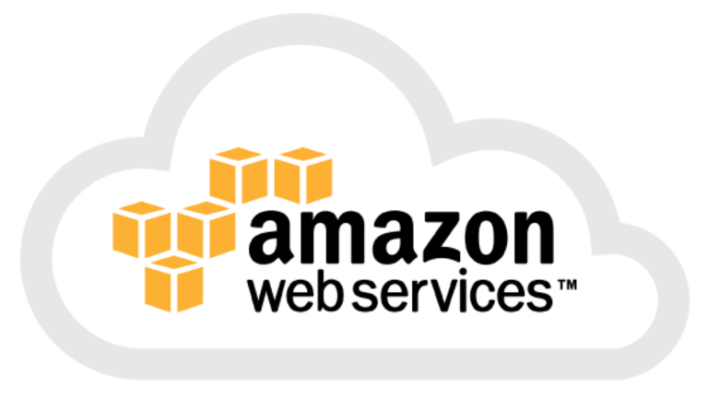
PRACTICAL SESSION :
Amazon Web Services (AWS) is a secure cloud services platform, offering compute power, database storage, content delivery and other functionality to help businesses scale and grow.
The AWS Cloud provides a broad set of infrastructure services, such as computing power, storage options, networking and databases, delivered as a utility: on-demand, available in seconds, with pay-as-you-go pricing.

Slide 22
Cloud Securities……….

Slide 23
Why Cloud Security? and…………….. What is Cloud Security?

Slide 24
Why Cloud Computing Security?
Cloud computing security is a fast-growing service that provides many of the same functionalities. This includes protecting critical information from theft, data leakage and deletion.

Slide 25
What is Cloud Computing Security?
Cloud computing security is the set of control-based technologies and policies designed to adhere to regulatory compliance rules and protect information, data applications and infrastructure associated with cloud computing use.

Slide 26


It is said that Cloud Security is a mixture of Art and Science… Why?

Slide 27
It is Science because you have to come up with new ways of securing your application . And Art because Authentication should be defined with user experience in mind.

Slide 28



Threat identification is done in 3 Stages in the Cloud .
Gaining Visibility
Monitoring data
Managing Access

Slide 29
How to Implement all stages in AWS ?

Slide 30
Monitoring….

Slide 31

AWS CloudWatch.
Monitor Amazon EC2 and Monitor Other AWS Resources
Monitor Custom Metrics
Set Alarms
Monitor and Store Logs
View Graphs and Statistics
Monitor and React to Resource Changes

Slide 32
Gaining Visibility….

Slide 33
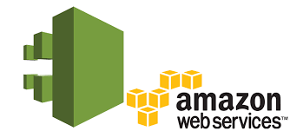
AWS Cloudtrail…..
AWS CloudTrail Log Files Delivery Failing (Security, operational-excellence)
Enable AWS CloudTrail multi-region API logging (Security)
Enable AWS CloudTrail logging for global services (Security)
AWS CloudTrail insecure buckets (Security)

Slide 34
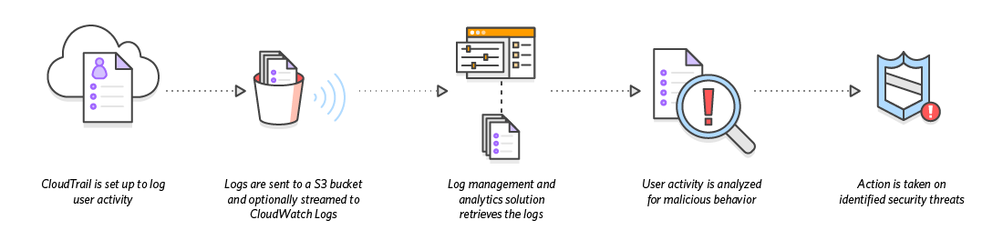

Slide 35

AWS IAM (Identity and Access Management)
Users – Create individual users.
Groups – Manage permissions with groups.
Permissions – Grant least privilege.
Auditing – Turn on AWS CloudTrail.
Password – Configure a strong password policy.
MFA – Enable MFA for privileged users.
Roles – Use IAM roles for Amazon EC2 instances.
Sharing – Use IAM roles to share access.
Rotate – Rotate security credentials regularly.
Conditions – Restrict privileged access further with conditions.
Root – Reduce or remove use of root.

Slide 36

Questions ? And Answers !

Slide 37





Thank You ! Follow Me : Slides Available :
/iamkumarji
/iamkumarji

